Slide 1
Molecular Replacement
Andrey Lebedev
YSBL, York

Slide 2
Modern Molecular Replacement
Model generation
online resources
internal databases
Molecular Replacement Search
Refinement
Search in the density
Scoring
Refinement
Model building

Slide 3
Molecular Replacement in CCP4
Programs
Molrep
AMoRe
Phaser
Pipelines
Balbes
MrBUMP
AMPLE

Slide 4
Molrep
Alexey Vagin
YSBL University of York

Slide 5
Molrep
Features
Model trimming to the target sequence
Model surface modification
Handling pseudo-NMR (ensemble) models
Anisotropic correction and scaling of the data
Analysing and handling pseudo-translation
Low- and high-pass filters accounting for model similarity and completeness
Conventional and Phased Rotation and Translation functions
Packing function
Conventional MR with atomic or map models
Fitting an atomic model into the electron density map
Fitting two models

Slide 6
Molrep
http://www.ysbl.york.ac.uk/~alexei/molrep.html
molrep -h
+-----------------------------------------+
| |
| --- MOLREP --- |
| /Vers 11.0.00; 17.06.2010/ |
| |
+-----------------------------------------+
##
## You can use program by command string with options:
##
# molrep -f <file_sf_or_map> -m <model_crd_or_map>
# -mx <fixed model> -m2 <model_2>
# -po <path_out> -ps <path_scrath>
# -s <file_sequence> -s2 <file_seq_for_m2>
# -k <file_keywords> -doc <y/a/n>
# -h -i -r
........

Slide 7
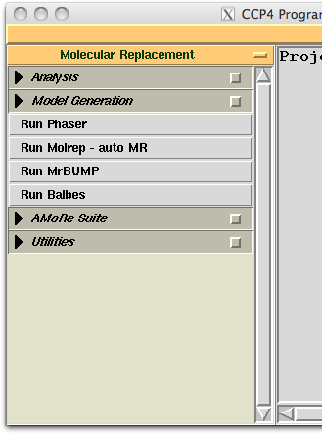
Molrep
molrep -f data.mtz -m model.pdb -mx fixed.pdb -s target.seq

Slide 8
Default protocol
molrep -f data.mtz -m model.pdb -mx fixed.pdb -s target.seq
model correction if sequence provided
defines the number of molecules per AU
modification of the model surface
anisotropic correction of the data
weighting the data according to model completeness and similarity
check for pseudotranslation and account for if present
30+ peaks in Cross RF for use in TF (accounts for close peaks)
applied packing function
Notes:
blah: do not whant to talk much about this
go through log-file and see what is there

Slide 9
Scripting
molrep -f data.mtz -m model.pdb -s target.seq –i <<+
nmon 1
sim 0.33
compl 0.1
np 100
pst N
+
You may want to define manually
the number of copies in the AU, if model is smaller than the target molecule
similarity (used for weighting), if e.g. the target sequence is not provided
completeness (used for weighting), to control weighting at low resolution
the number of top peaks from CRF to be tested by TF
to switch two-copy search off (switched on by default if pseudotranslation is found).
Notes:
blah: do not whant to talk much about this
go through log-file and see what is there

Slide 10
Log-file

Slide 11
Self Rotation Function (SRF)
molrep -f data.mtz
Example
Space group P21
One 222-tetramer in the AU
molrep -f data.mtz –i <<+
rad 20
resmax 2.5
resmin 8.0
lmin 6
+
Chi = 180°
Output
molrep_rf.ps
molrep_srf.tab
LMIN < 0 (default)
harmonics with L=2 are removed
harmonics with L=4 are downweighted
Y
X
Notes:
In words:
A single outlier may corrupt SRF
LMIN controls harmonics of low order

Slide 12
SRF: preliminary analysis of X-ray data
Oligomeric state of the protein in crystal
Content of the asymmetric unit
Does crystal contain the right protein?
Be careful: artifacts in SRF, twinning, pseudo-translation
Selection of oligomeric search model for MR
Be careful, oligomers with the same symmetry can be different
Rare use: check for isomorphous or anomalous signal

Slide 13
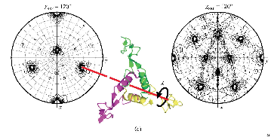
SRF: use for structure solution
Locked Rotation Function
Helps restrict dimensionality in an exhaustive search
molrep -f s100.mtz -m monomer.pdb -s s100.seq –i <<+
lock y
file_tsrf molrep_srf.tab
nsrf 1
+

Slide 14
Search in the density
Completion of model
addition of smaller domain(s) < molrep tutorial
NCS: "the last subunit" problem
high temperature factors in one of the subunits
subunit in a special crystallographic environment
Experimental phasing
Both experimental phases and model are poor
Low resolution X-ray data
Interpretation of EM reconstruction
Notes:
Example will show what special crystallographic environement could mean
High temperature factors and special environement: low contrast in RF and conventional TF

Slide 15
Exhaustive search in the electron density
FFFear: Fast Fourier Feature Recognition
Clever 6-dimensional search by Kevin Cowtan
1. Sample the 3-dimensional space of rotations
For example, for orthorhombic space group, search step 6.0° requires 14098 orientations (a couple of hours)
2. Find the best position(s) for each orientation
The fast Phased Translation Function
3. Sort solution and find the overall best model
Notes:
Here: about search in the density in general

Slide 16
Modified Rotation Function
Why not using Rotation Function?
1. Find orientation:
Cross-rotation function (no phases used)
2. Find position:
Phased translation function
Model completion:
Small domains or subunits to be added
Therefore the Rotation Function may fail
No peaks for the domains or subunits of interest
Notes:
Here we are talking particularly about model completion
Instead of Exhaustive search, we still may use the rotation function
More peaks if necessary, but still this will be much less tested orientations than in the exhaustive search.

Slide 17
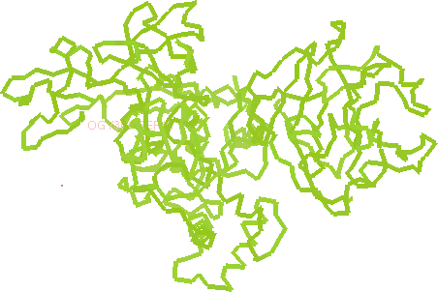
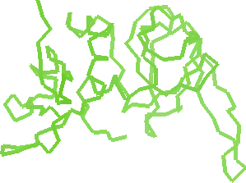
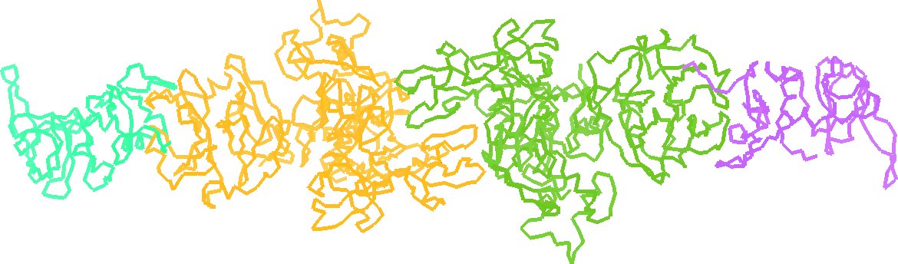
Example
Templates:
Target structure:
Matrix metalloproteinase-2 with its inhibitor
Morgunova et al. (2002) PNAS 99, 7414
resolution 3.1 A
Solution:
A, B: by conventional MR
C, D: using FFFear
also can be solved by iterating refinement and search in the density
1ck7
1br9
1gxd
C
A
B
D

Slide 18
Modified Rotation Function
Refine partial model
Calculate map coefficients (2-1 or 1-1)
Flatten the map corresponding to the known substructure
Calculate structure amplitudes from this map
Use them in Cross-Rotation Function
And finally – Phased TF
refmac5 ... hklout AB.mtz xyzout AB.pdb ...
molrep -f AB.mtz -mx AB.pdb -m model.pdb -i <<+
labin F=FWT PH=PHWT
sim -1
nmon 1
np 100
diff m
+
Notes:
Here we are talking particularly about model completion

Slide 19
Example
Search for C in the density from refined A+B:
Search for D in the density from refined A+B+C:
--- Summary ---
+------------------------------------------------------------------------------+
| RF TF theta phi chi tx ty tz TFcnt wRfac Score |
+------------------------------------------------------------------------------+
| 1 38 2 88.09 -107.50 4.93 0.763 0.000 0.200 9.00 0.661 0.090 |
| 2 33 2 83.41 -96.71 5.51 0.763 0.000 0.200 9.38 0.661 0.090 |
| 3 31 2 177.53 -175.94 179.16 0.236 0.000 0.699 9.49 0.661 0.089 |
| 4 27 2 167.32 -104.44 51.93 0.850 0.000 0.388 2.57 0.662 0.082 |
--- Summary ---
+------------------------------------------------------------------------------+
| RF TF theta phi chi tx ty tz TFcnt wRfac Score |
+------------------------------------------------------------------------------+
| 1 88 1 172.00 -133.61 173.03 0.609 0.511 0.139 20.89 0.650 0.096 |
| 2 86 1 171.51 -130.07 173.56 0.108 0.011 0.140 16.55 0.650 0.095 |
| 3 87 1 172.85 -130.98 175.04 0.109 0.011 0.140 14.27 0.650 0.095 |
| 4 59 1 165.81 -139.35 167.51 0.125 0.010 0.143 9.97 0.650 0.093 |

Slide 20
Modified Rotation Function
Useful rules
Add one domain at time, "NMON 1"
Use "SIM –1" (Refinement has already weighted the map coefficients)
Use many picks of RF, e.g. "NP 100"
The second copy of a domain is sometimes easier to find using its refined copy found previously (a correct solution of the first copy)
Compared to the likelihood based RF
The likelihood estimates for map coefficients are obtained from refinement
In addition, the known substructure is improved before next search
In addition, the noise in the map from known substructure is removed
This method is implemented in the MR pipeline Balbes
Notes:
Here we are talking particularly about model completion

Slide 21
SAPTF
Spherically Averaged Phased Translation Function
(FFT based algorithm)
Notes:
Here: about search in the density in general
"Back to the general problem of searching in the density"

Slide 22
MR with SAPTF
1. Find approximate position:
Spherically Averaged Phased Translation Function
2. Find orientation:
Phased Rotation Function
Local search of the orientation in the density
3. Verify and adjust position:
Phased Translation Function
Notes:
Here: about search in the density in general

Slide 23
SAPTF Example
X-ray data:
Crystal of cyanobacterial sucrose-phosphatase
PDB code 1tj3
Resolution, 2.8 Å
Model:
Identity to the target 100%
Different conformation
PDB code 1s2o
Derived models:
domain 1
172 residues (1-77, 159-244)
domain 2
72 residues (88-159)

Slide 24
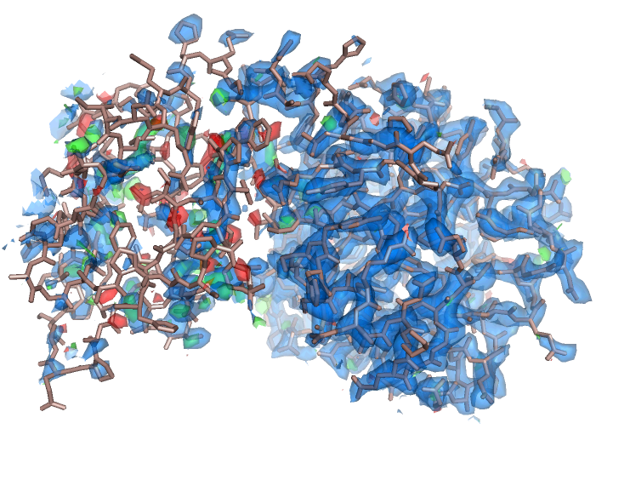
SAPTF Example
Attempt to find the complete search model (Conventional RF + TF protocol)
Input:
X-ray data
search model
molrep -f 1tj3.mtz -m 1s2oA.pdb
After refinement

Slide 25
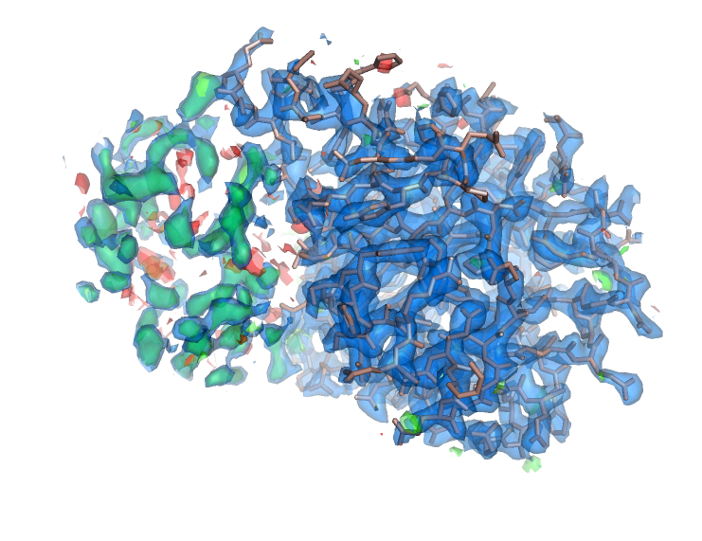
SAPTF Example
Search for the large domain (Conventional RF + TF protocol)
Input:
X-ray data
search model
molrep -f 1tj3.mtz -m 1s2oA_dom1.pdb
After refinement

Slide 26
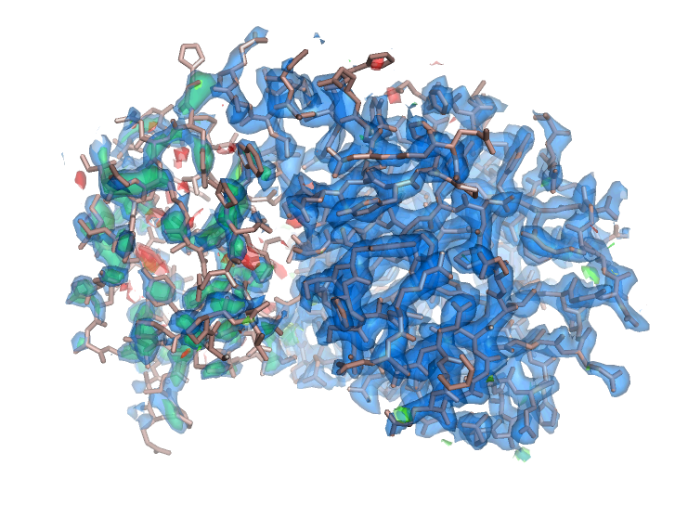
SAPTF Example
Search for the small domain (SAPTF + Phased RF + Phased TF)
Input:
Map coefficients
Search model
Partial structure
used as a mask
used for Packing Function
passed to output PDB-file
molrep -f data.mtz -m 1s2oA_dom2.pdb -i <<+
diff M
labin FP=FWT PHIC=PHIWT
prf Y
sim -1
+
Before refinement

Slide 27
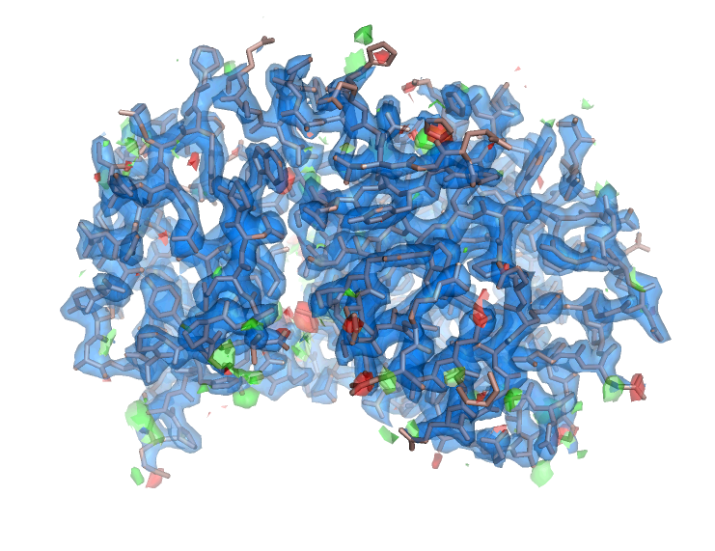
SAPTF Example
Search for the small domain (SAPTF + Phased RF + Phased TF)
Tutorial data (typo in tutorial materials)
http://www.ysbl.york.ac.uk/~alexei/downloads/tutorial_MR.tar.gz
CCP4I
this workshop materials
Command line:
tutorial data
tutorial.pdf, section 2
After refinement

Slide 28
Alternative SAPTF protocol
SAPTF estimate of the position is not very precise
Passed RF is sensitive to eccentricity of the model in its map
Possible treatment (see also molrep tutorial)
1. Find approximate position:
Spherically Averaged Phased Translation Function
2. Find orientation:
Local Phased Rotation Function
The sphere used in SAPTF is used again, this time as a mask
Structure amplitudes from the density in the same sphere
3. Verify and adjust position:
Phased Translation Function

Slide 29
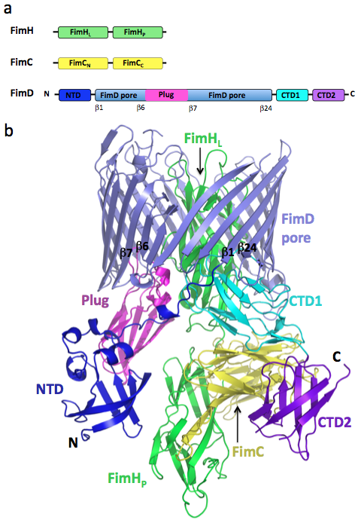
More complicated example
Asymmetric unit two copies
Resolution 2.8 Å
Phane et. al (2011) Nature, 474, 50-53

Slide 30
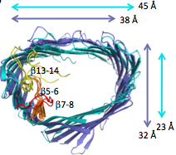
Usher complex structure solution
1. Conventional MR
FimC-N + FimC-C
FimH-L + FimH-P
FimD-Pore
2. Jelly body refinement (Refmac)
FimD-Pore
3. Fitting into the electron density
FimD-Plug
FimD-NTD
FimD-CTD-2
4. Manual building
FimD-CTD-1
Notes:
Essential steps of strcture solution, and, particularly, what we are interested in, the fitting into the density

Slide 31
Performance of fitting methods
 | search model | sequence identity | "Masked" RF PTF prf n | SAPTF PRF PTF prf y | SAPTF Local RF PTF prf s
FimD-Plug | 3fip_A | 38.5% | 2 (2) | – (–) | 1 (2)
FimD-NTD | 1ze3_D | 100% | 2 (2) | 1 (2) | 2 (2)
FimD-CTD-2 | 3l48_A | 33.3% | – (–) | 2 (2) | – (–)
Trying several methods is a good practice (also because of cross-validation)
Notes:
Essential steps of strcture solution, and, particularly, what we are interested in, the fitting into the density
Series of slides with pictures?

Slide 32
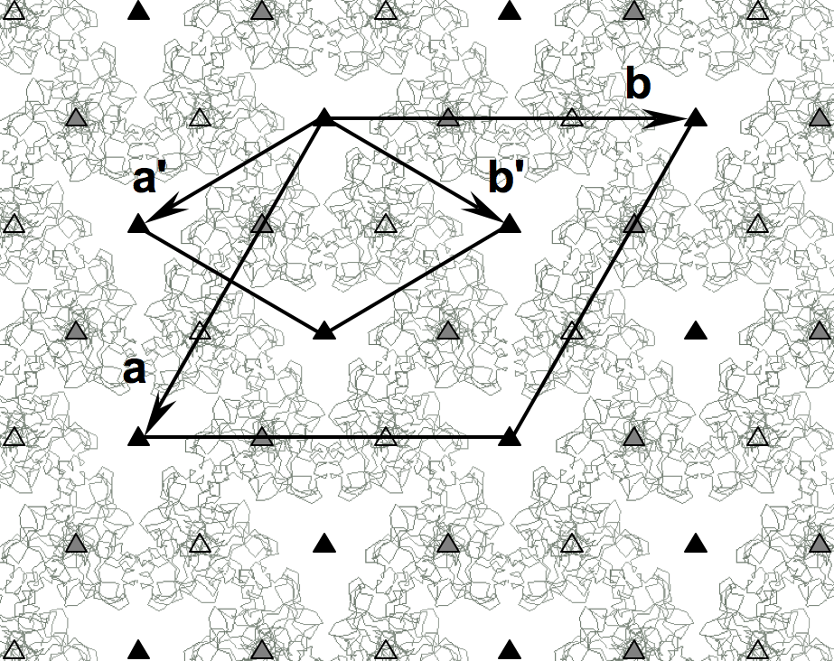
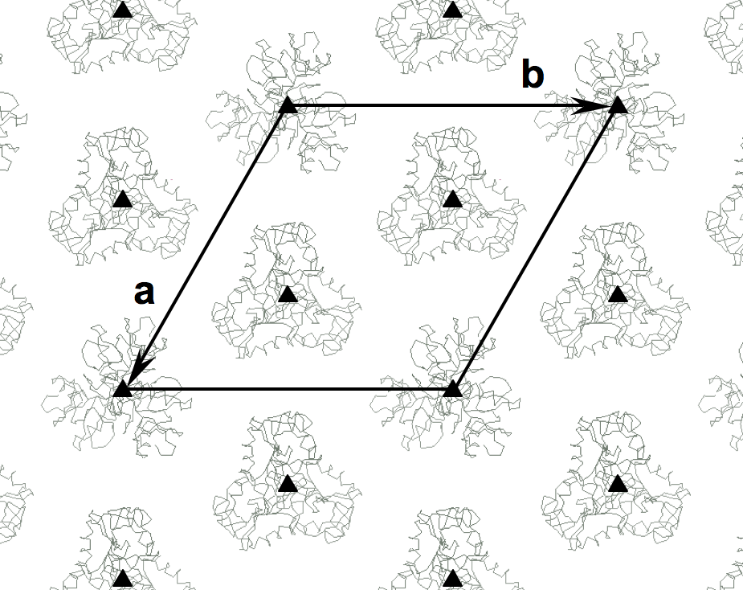
NCS copy in a special position
False origin solution:
Is an artifact of Molecular replacement in the presence of pseudotranslation
The most recent example:
Twinning + three alternative origins in a substructure:
True origins
False origins
All origins are equivalent in the small cell
P3₁21 (a' b' c)
P3₁ (a b c)
Watson et al. (2011). JBC, online pre-publication.
Notes:
Rerender it?

Slide 33
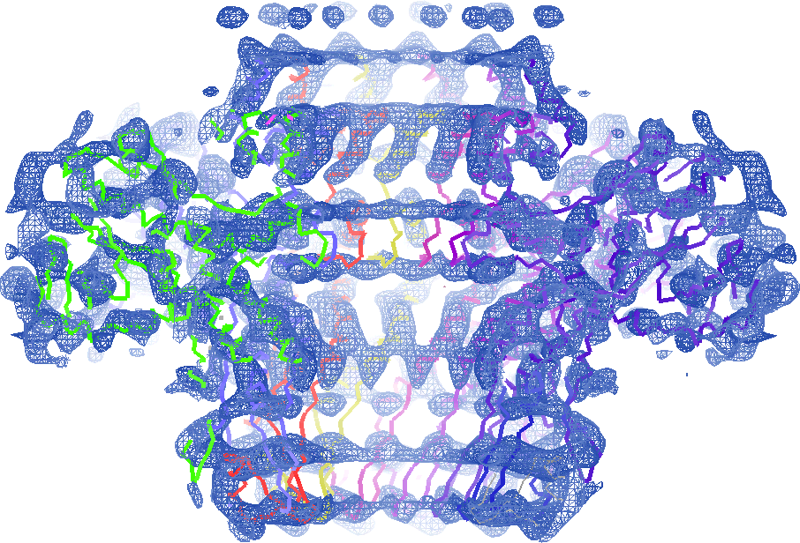
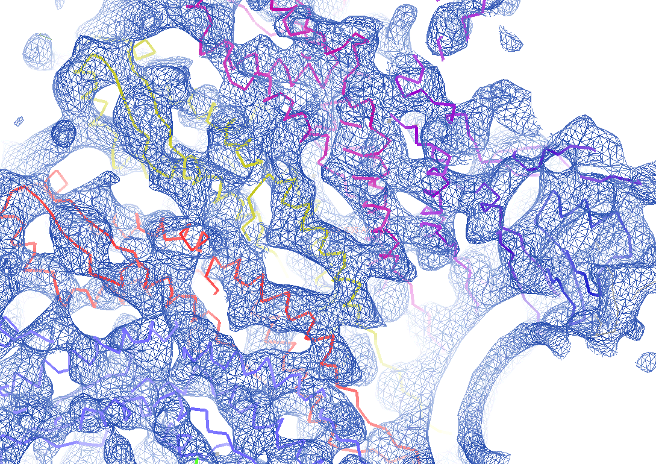
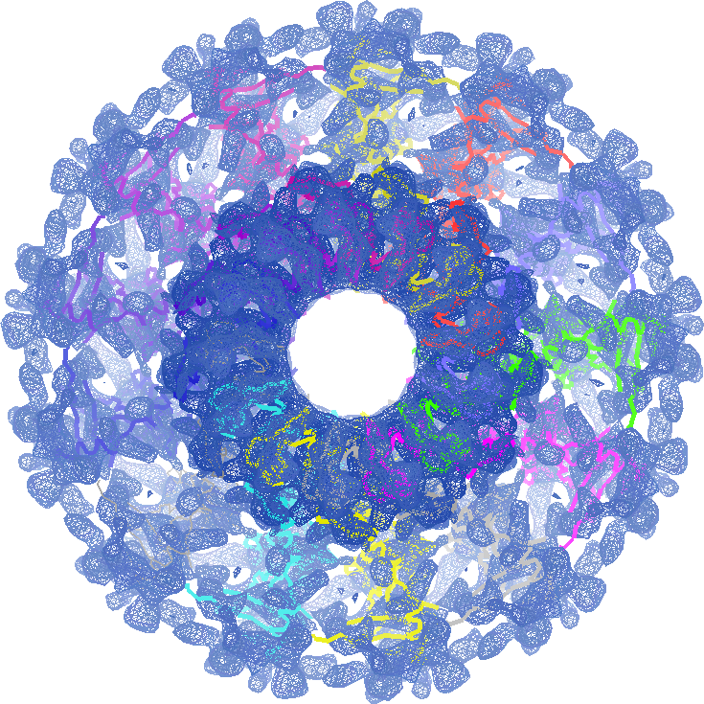
Fitting into EM maps

Slide 34
Balbes
Fei Long
Garib Murshudov
MRC LMB Cambridge
Alexey Vagin
YSBL University of York

Slide 35
Balbes features
Input: mtz-file and sequence
Output: the best solution search models for manual investigation
Balbes has a database containing preprocessed data from the PDB
updated mongthly
used for generation of models for given sequence
different types of models
any model is an ensemble if possible
Can handle complexes
several sequences in the input sequence file
Strucrure solution using Molrep and Refmac
Uses the search in the density for second, third etc component

Slide 36
Database
Non-redundant chains from the PDB
The PDB entries of better resolution are preferred
More than 30000 domain definitions
flexible parts removed
hierarchically organized according to 3D similarity
Multimers
generated using PISA definition

Slide 37
Model preparation
All models are corrected by sequence alignment
and by accessible surface area
Chain 1
domains
multimer
NO
Chain 2
domains
multimer
Multi-domain model

Slide 38
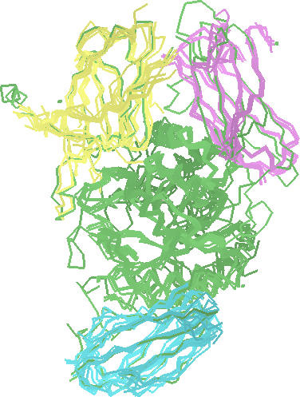
Ensemble models from Balbes
Homologues from the Balbes database:
Ensemble search models:
Example:
Reference chain
Reference chain
on the top
Notes:
Balbes:
Utilised search in the density for second and next models
(The order of search depends on on whether or not domains are present, sizes of domains, etc)
Yet another important detail: ensemble models

Slide 39
Ensemble models from Balbes
If ensemble model is possible, it is generated
Reference chain: occupancy = 1
Other chains: occupancy < 1
depends on the similarity of this chain with the reference chain
Reference chain is corrected according to the target sequence
Reference chain is passed to refinement
and the one from the best solution to output
Firstly, try Balbes. If it fails, take generated models and try manual MR
MODEL 1 1.000 2b1qA
ATOM 1 N MET A 1 54.911 30.868 97.738 1.00 28.22 ...
...
MODEL 8 0.000 2b1qA
ATOM 1 N TYR A 2 62.248 23.657 102.889 0.49 60.31 ...
...

Slide 40
Ensemble models from Balbes

Slide 41
Ensemble models from Balbes
All files:
results > AllFilesIn_7587375708.tar.gz

Slide 42
Acknowledgements
Alexey Vagin University of York
Fei Long MRC LMB
Garib Murshudov MRC LMB

