Slide 1
Search in electron density using Molrep
Andrey Lebedev
CCP4

Slide 2
Molecular Replacement
≈ 35% PHASER
≈ 20% MOLREP
≈ 10% AMORE
≈ 1% EPMR

Slide 3
Molrep
http://www.ysbl.york.ac.uk/~alexei/

Slide 4
Molrep
molrep -h
+-----------------------------------------+
| |
| --- MOLREP --- |
| /Vers 11.0.00; 17.06.2010/ |
| |
+-----------------------------------------+
##
## You can use program by command string with options:
##
# molrep -f <file_sf_or_map> -m <model_crd_or_map>
# -mx <fixed model> -m2 <model_2>
# -po <path_out> -ps <path_scrath>
# -s <file_sequence> -s2 <file_seq_for_m2>
# -k <file_keywords> -doc <y/a/n>
# -h -i -r
........

Slide 5
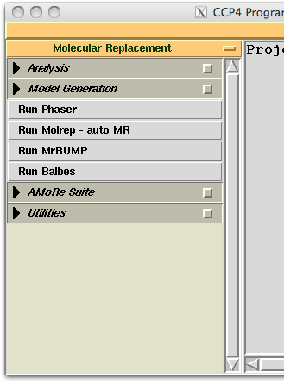
Conventional MR
molrep -f data.mtz -m model.pdb -mx fixed.pdb -s target.seq

Slide 6
Conventional MR: default protocol
molrep -f data.mtz -m model.pdb -mx fixed.pdb -s target.seq
model correction if sequence provided
defines the number of molecules per AU
modification of the model surface
anisotropic correction of the data
weighting the data according to model completeness and similarity
check for pseudotranslation; two-copy search if PT is present
30+ peaks in Cross RF for use in TF (accounts for close peaks)
applied packing function
Notes:
blah: do not whant to talk much about this
go through log-file and see what is there

Slide 7
Conventional MR: important options
molrep -f data.mtz -m model.pdb –i <<+
nmon 1
sim 0.33
compl 0.1
np 100
pst N
+
You may want to define manually
the number of copies in the AU, if model is smaller than the target molecule
similarity (used for weighting), if e.g. the target sequence is not provided
completeness (used for weighting), to control weighting at low resolution
the number of top peaks from CRF to be tested by TF
to switch two-copy search off (switched on by default if pseudotranslation is found).
Notes:
blah: do not whant to talk much about this
go through log-file and see what is there

Slide 8
Conventional MR: log-file

Slide 9
Input data define what Molrep does
Fitting two models
Fitting model into a map
Map is a search model
Self-Rotation Function
Help
molrep –mx fixed_model.pdb –m model.pdb
molrep –f map.ccp4 –m model.pdb
molrep –f data.mtz –m map.ccp4
molrep –f data.mtz
molrep –h

Slide 10
Ensemble (pseudo-NMR) models
Combine
structure factors
Combine
intensities for RF
structure factors for TF
molrep -f data.mtz -m nmr.pdb
molrep -f data.mtz -m nmr.pdb –i <<+
nmr 1
+

Slide 11
Multi-copy search
Multimer is assembled (using RF + TF in P1 with F₁ × F₂*)
Multimer is used as a search model in conventional Translation Function
One model
Two models
molrep –f data.mtz –m model.pdb –m2 model.pdb –i <<+
dyad M
+
molrep –f data.mtz –m model_1.pdb –m2 model_2.pdb –i <<+
dyad M
+

Slide 12
Search in the density
Completion of model
addition of smaller domain(s) << tutorial
NCS: "the last subunit" problem
high temperature factors in one of the subunits
subunit in a "special" position
Experimental phasing
Both experimental phases and model are poor
Low resolution X-ray data
Interpretation of EM reconstruction
Notes:
Example will show what special crystallographic environement could mean
High temperature factors and special environement: low contrast in RF and conventional TF

Slide 13
Search in the density using Rotation Function
1. Find orientation:
Rotation Function
(Matching Patterson functions – noise from other domains and orientations)
(Phase information is not used)
2. Find position:
Phased Translation Function
Not very good for model completion:
Small part of domains or subunits to be added
Therefore the Rotation Function may fail
No peaks for the domains or subunits of interest
Notes:
Here we are talking particularly about model completion
Instead of Exhaustive search, we still may use the rotation function
More peaks if necessary, but still this will be much less tested orientations than in the exhaustive search.

Slide 14
Exhaustive search in the electron density
FFFear: Fast Fourier Feature Recognition
Clever 6-dimensional search by Kevin Cowtan
1. Sample the 3-dimensional space of rotations
For example, for orthorhombic space group, search step 6.0° requires 14098 orientations (slow – can take several hours)
2. Find the best position(s) for each orientation
The fast Phased Translation Function
3. Sort solution and find the overall best model
Notes:
Here: about search in the density in general

Slide 15
Modified Rotation Function
Refine partial model
Calculate map coefficients (2-1 or 1-1)
Flatten the map corresponding to the known substructure
Calculate structure amplitudes from this map
Use them in Rotation Function
And finally – Phased TF
refmac5 ... hklout AB.mtz xyzout AB.pdb ...
molrep -f AB.mtz -mx AB.pdb -m model.pdb -i <<+
labin F=FWT PH=PHWT
sim -1
nmon 1
np 100
diff m
+
Notes:
Here we are talking particularly about model completion

Slide 16
Modified Rotation Function
Useful rules
Add one domain at time,
Use (Refinement has already weighted the map coefficients)
Use many picks of RF, e.g.
The second copy of a domain is sometimes easier to find using its refined copy found previously (a correct solution of the first copy)
Compared to the likelihood based RF
The likelihood estimates for map coefficients are obtained from refinement
In addition, the known substructure is improved before next search
In addition, the noise in the map from known substructure is removed
This method is implemented in the MR pipeline Balbes
NMON 1
SIM -1
NP 100
Notes:
Here we are talking particularly about model completion

Slide 17
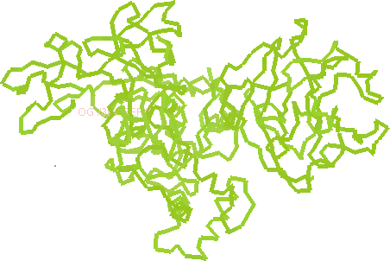
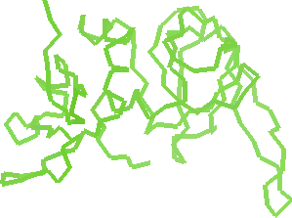
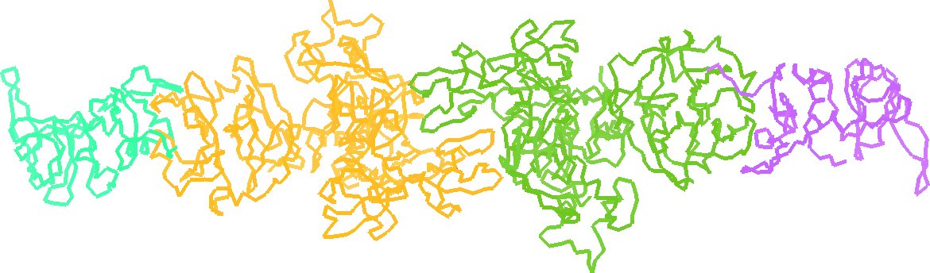
Example
Templates:
Target structure:
Matrix metalloproteinase-2 with its inhibitor
Morgunova et al. (2002) PNAS 99, 7414
resolution 3.1 A
Solution:
A, B: conventional MR
C, D: search in the density
1ck7
1br9
1gxd
C
A
B
D

Slide 18
Example
Search for C in the density from refined A+B:
Search for D in the density from refined A+B+C:
--- Summary ---
+------------------------------------------------------------------------------+
| RF TF theta phi chi tx ty tz TFcnt wRfac Score |
+------------------------------------------------------------------------------+
| 1 38 2 88.09 -107.50 4.93 0.763 0.000 0.200 9.00 0.661 0.090 |
| 2 33 2 83.41 -96.71 5.51 0.763 0.000 0.200 9.38 0.661 0.090 |
| 3 31 2 177.53 -175.94 179.16 0.236 0.000 0.699 9.49 0.661 0.089 |
| 4 27 2 167.32 -104.44 51.93 0.850 0.000 0.388 2.57 0.662 0.082 |
--- Summary ---
+------------------------------------------------------------------------------+
| RF TF theta phi chi tx ty tz TFcnt wRfac Score |
+------------------------------------------------------------------------------+
| 1 88 1 172.00 -133.61 173.03 0.609 0.511 0.139 20.89 0.650 0.096 |
| 2 86 1 171.51 -130.07 173.56 0.108 0.011 0.140 16.55 0.650 0.095 |
| 3 87 1 172.85 -130.98 175.04 0.109 0.011 0.140 14.27 0.650 0.095 |
| 4 59 1 165.81 -139.35 167.51 0.125 0.010 0.143 9.97 0.650 0.093 |

Slide 19
SAPTF
Spherically Averaged Phased Translation Function
(FFT based algorithm)
Notes:
Here: about search in the density in general
"Back to the general problem of searching in the density"

Slide 20
MR with SAPTF
1. Find approximate position:
Spherically Averaged Phased Translation Function
2. Find orientation:
Phased Rotation Function
Local search of the orientation in the density
3. Verify and adjust position:
Phased Translation Function
Notes:
Here: about search in the density in general

Slide 21
SAPTF Example
X-ray data:
Crystal of cyanobacterial sucrose-phosphatase
PDB code 1tj3
Resolution, 2.8 Å
Model:
Identity to the target 100%
Different conformation
PDB code 1s2o
Derived models:
domain 1
172 residues (1-77, 159-244)
domain 2
72 residues (88-159)

Slide 22
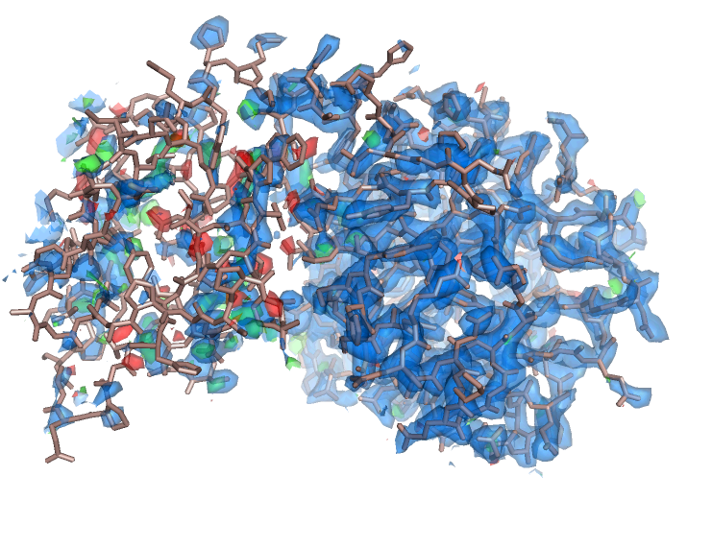
SAPTF Example
Attempt to find the complete search model (Conventional RF + TF protocol)
Input:
X-ray data
search model
molrep -f 1tj3.mtz -m 1s2oA.pdb
After refinement

Slide 23
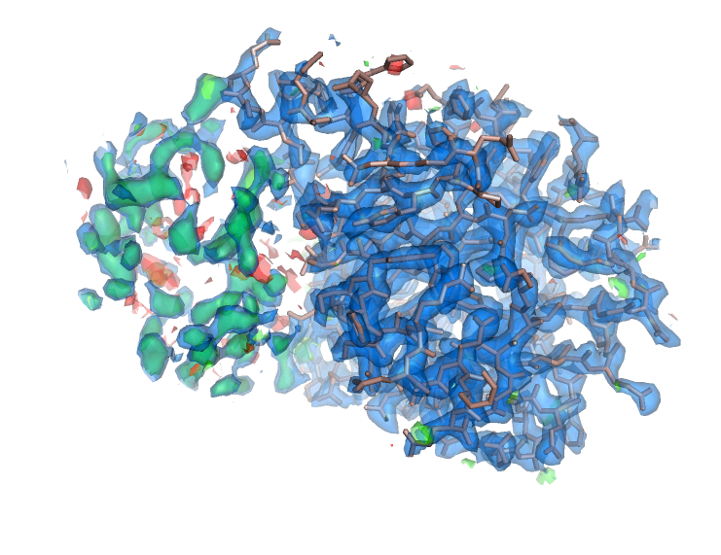
SAPTF Example
Search for the large domain (Conventional RF + TF protocol)
Input:
X-ray data
search model
molrep -f 1tj3.mtz -m 1s2oA_dom1.pdb
After refinement

Slide 24
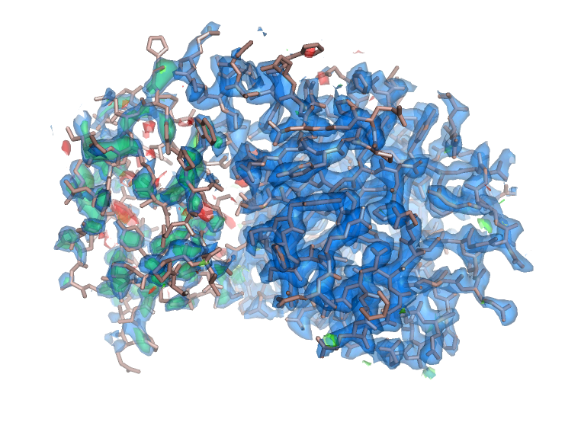
SAPTF Example
Search for the small domain (SAPTF + Phased RF + Phased TF)
Input:
Map coefficients
Search model
Partial structure
used as a mask
used for Packing Function
passed to output PDB-file
molrep -f data.mtz -m 1s2oA_dom2.pdb -mx fixed.pdb -i <<+
diff M
labin FP=FWT PHIC=PHIWT
prf Y
sim -1
+
Before refinement

Slide 25
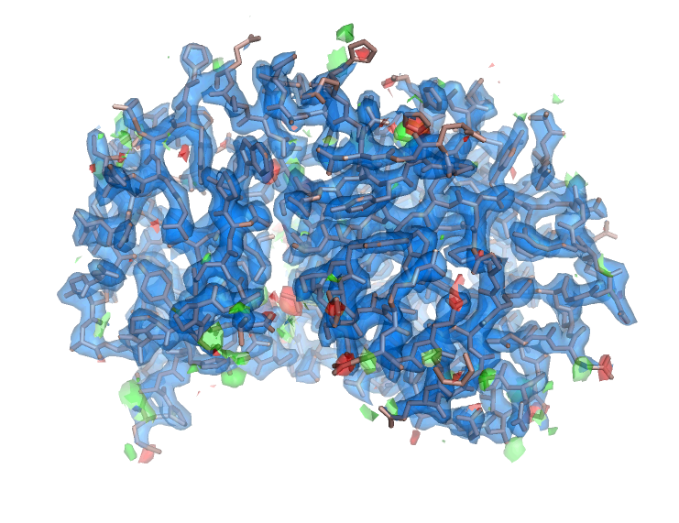
SAPTF Example
Search for the small domain (SAPTF + Phased RF + Phased TF)
After refinement

Slide 26
Alternative SAPTF protocol
SAPTF estimate of the position is not very precise
Passed RF is sensitive to eccentricity of the model in its map
Possible treatment (see also molrep tutorial)
1. Find approximate position:
Spherically Averaged Phased Translation Function
2. Find orientation:
Local Phased Rotation Function: keyword
The sphere used in SAPTF is used again, this time as a mask
Structure amplitudes from the density in the same sphere
3. Verify and adjust position:
Phased Translation Function
PRF S

Slide 27
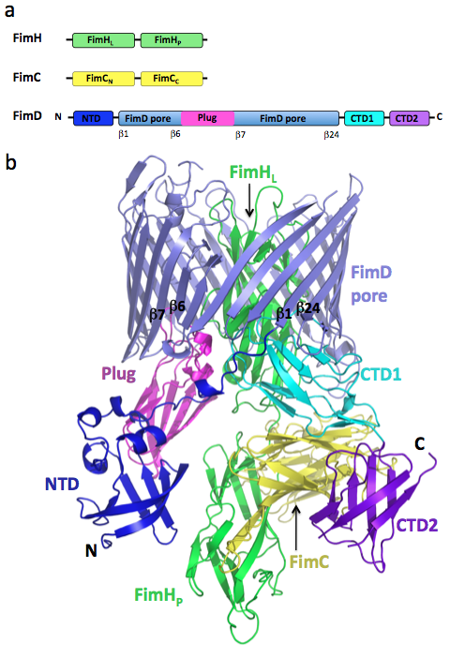
More complicated example
Asymmetric unit two copies
Resolution 2.8 Å
Phane et. al (2011) Nature, 474, 50-53

Slide 28
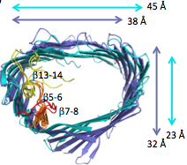
Usher complex structure solution
1. Conventional MR
FimC-N + FimC-C
FimH-L + FimH-P
FimD-Pore
2. Jelly body refinement (Refmac)
FimD-Pore
3. Fitting into the electron density
FimD-Plug
FimD-NTD
FimD-CTD-2
4. Manual building
FimD-CTD-1
Notes:
Essential steps of strcture solution, and, particularly, what we are interested in, the fitting into the density

Slide 29
Performance of fitting methods
 | search model | sequence identity | "Masked" RF PTF prf n | SAPTF PRF PTF prf y | SAPTF Local RF PTF prf s
FimD-Plug | 3fip_A | 38.5% | 2 (2) | – (–) | 1 (2)
FimD-NTD | 1ze3_D | 100% | 2 (2) | 1 (2) | 2 (2)
FimD-CTD-2 | 3l48_A | 33.3% | – (–) | 2 (2) | – (–)
PRF N
PRF Y
PRF S
Trying several methods is a good practice (also because of cross-validation)
Notes:
Essential steps of strcture solution, and, particularly, what we are interested in, the fitting into the density
Series of slides with pictures?

Slide 30
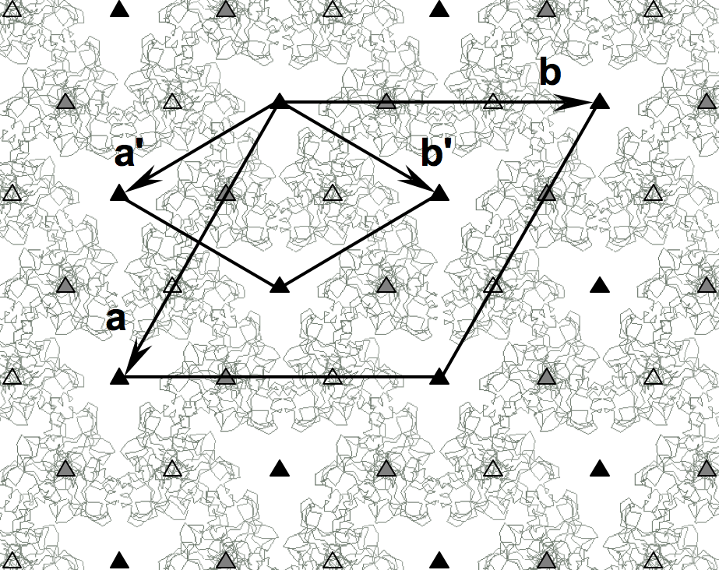
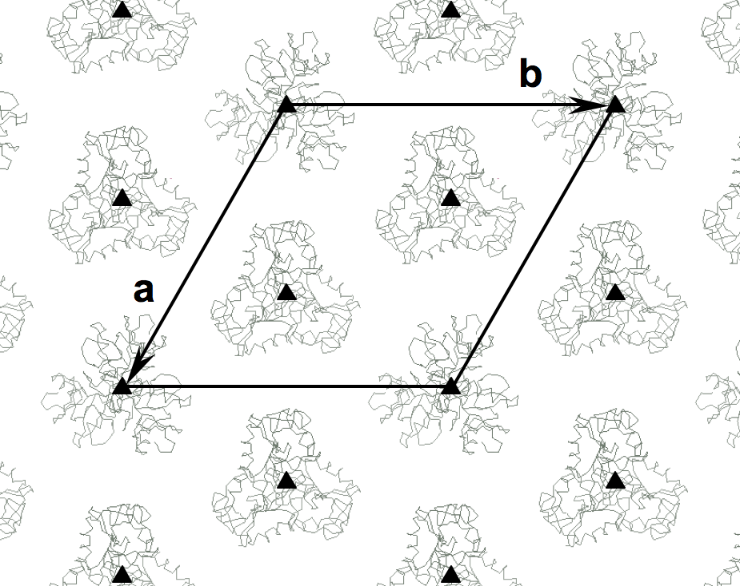
NCS copy in a special position
Substructure 1 Substructure 2
Orientations from 1 are twice more frequent than from 2
Twinning: orientations from 1 are four times more frequent than from 2
No peaks in conventional RF for orientations from 2
Substructure 2 was solved using search in the density
P3₁21 (a' b' c)
P3₁ (a b c)
Watson et al. (2011). JBC.
Notes:
Rerender it?

Slide 31
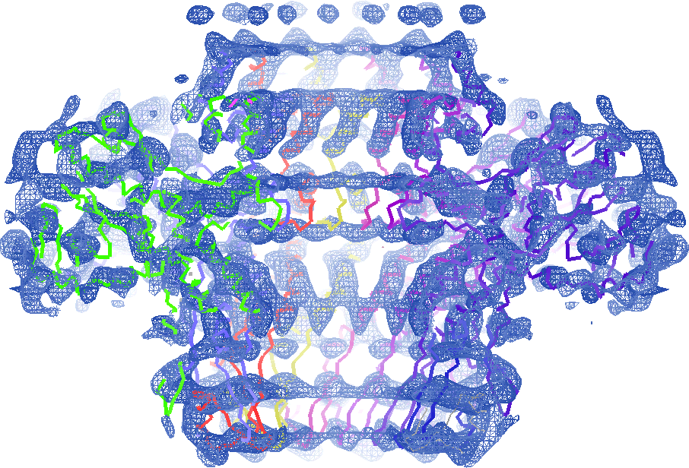
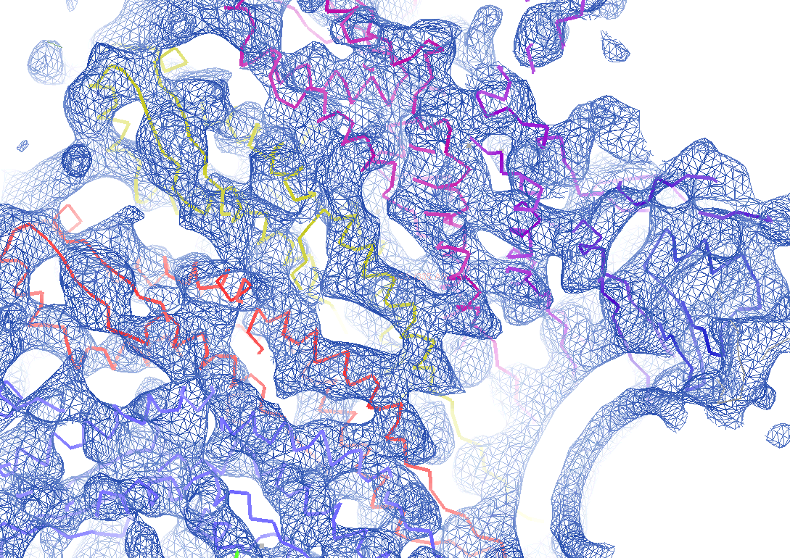
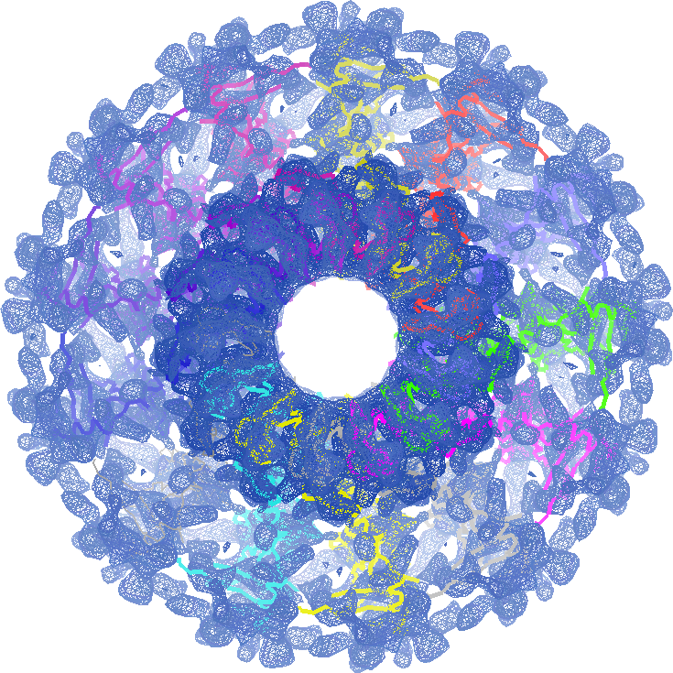
Fitting into EM maps

Slide 32
Tutorial: model completion using Molrep
Step by step instructions:
http://www.ysbl.york.ac.uk/mxstat/andrey/molrep.pdf
This presentation:
http://www.ysbl.york.ac.uk/mxstat/andrey/molrep_SAPTF.pptx
Tutorial data:
http://www.ysbl.york.ac.uk/~alexei/downloads/tutorial_MR.tar.gz

